Slide 1

WELCOME TO:
General Meeting
6 PM Tuesday, October 9th, 2018
Broun Hall, Room 125

Slide 2
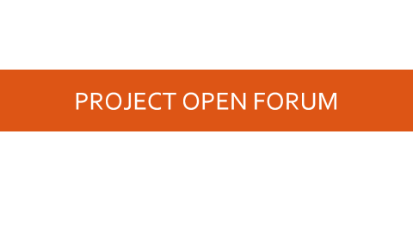

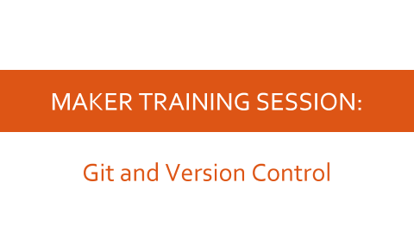
AGENDA

Slide 3
ABOUT SPARC

Slide 4
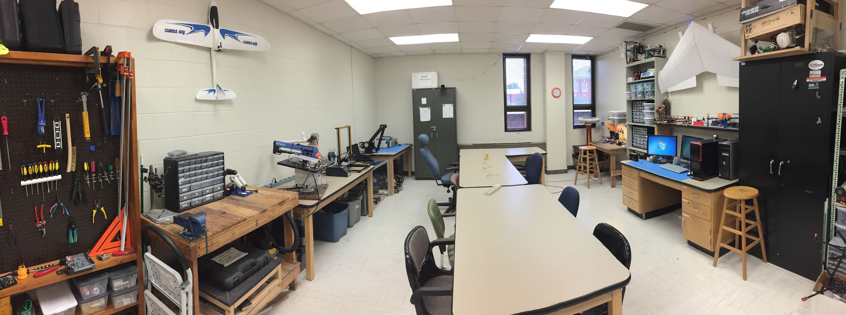
ABOUT SPARC
Creates and fosters an environment of creativity and innovation through collaborative projects.
A place to test out ideas, integrate concepts learned in class, and learn skills that will be instrumental when working in the workforce.
No prior experience is required, only a willingness to learn.
Lab:
- Broun 367
General Meetings:
- Tuesdays @ 6 in Broun 125
Project Meetings:
- Various Times during week

Slide 5
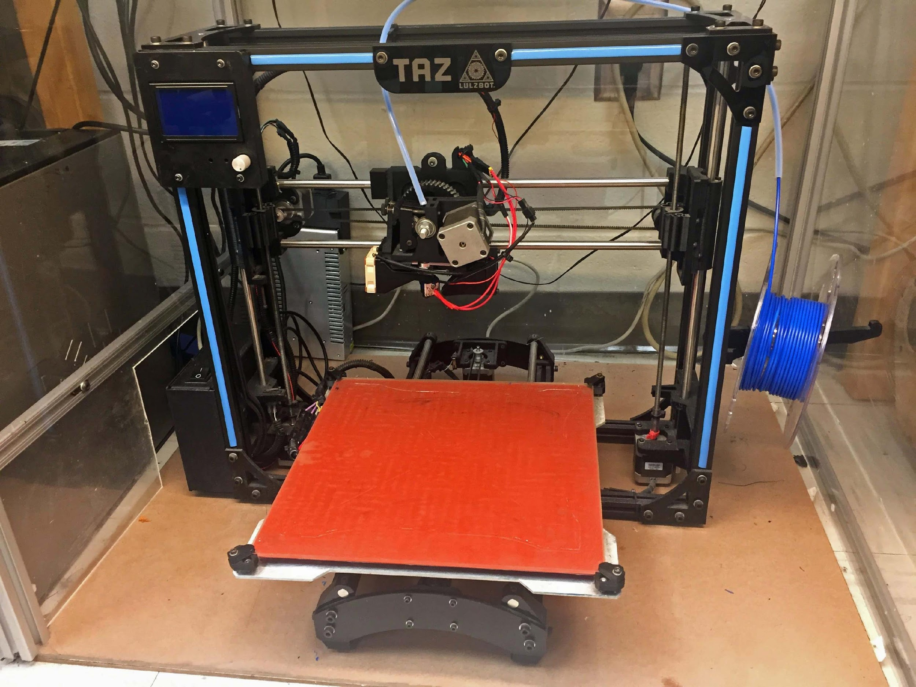
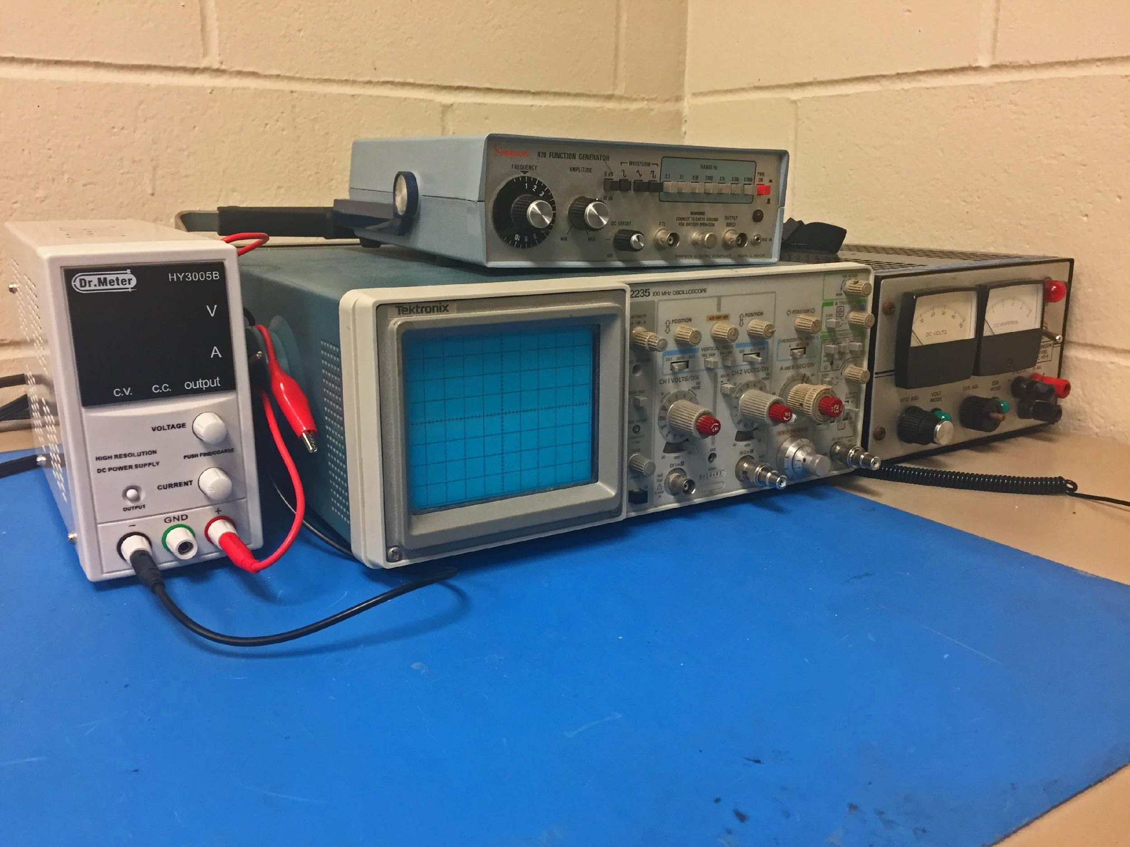
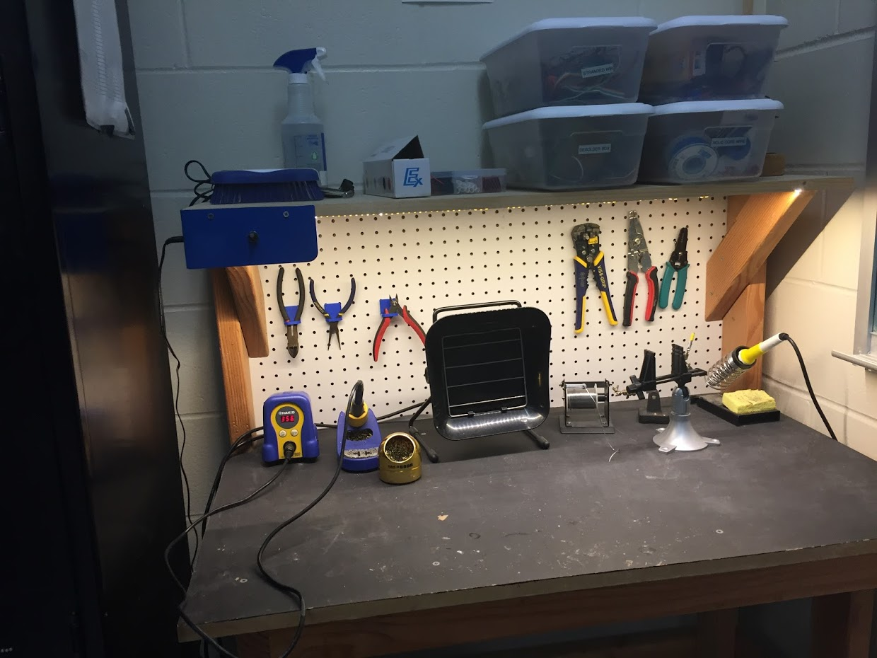
OUR LAB
Broun Hall
Room 367

Slide 6
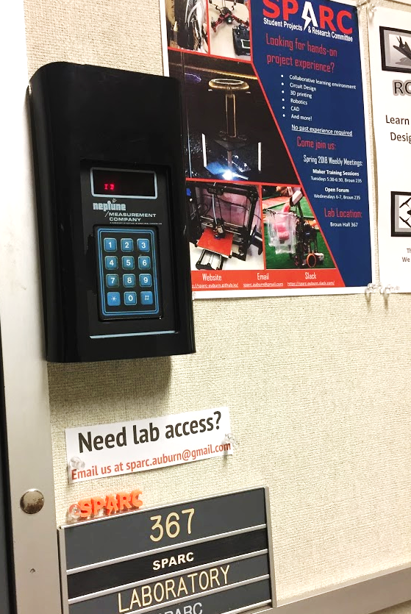
HOW TO BECOME A MEMBER
Log 5 constructive hours in the lab
Write the times on the sheet on the clipboard next to the door.
Contact us at sparc.auburn@gmail.com
We will respond with the instructions to get an access code.

Slide 7




MORE INFORMATION ABOUT SPARC
Website
http://sparc.eng.auburn.edu/
Github
https://github.com/SPARC-Auburn
Slack
https://sparc-auburn.slack.com/
Email
sparc.auburn@gmail.com

Slide 8
QUESTIONS?
Notes:
6:10

Slide 9
OUTREACH AND RECRUITMENT

Slide 10
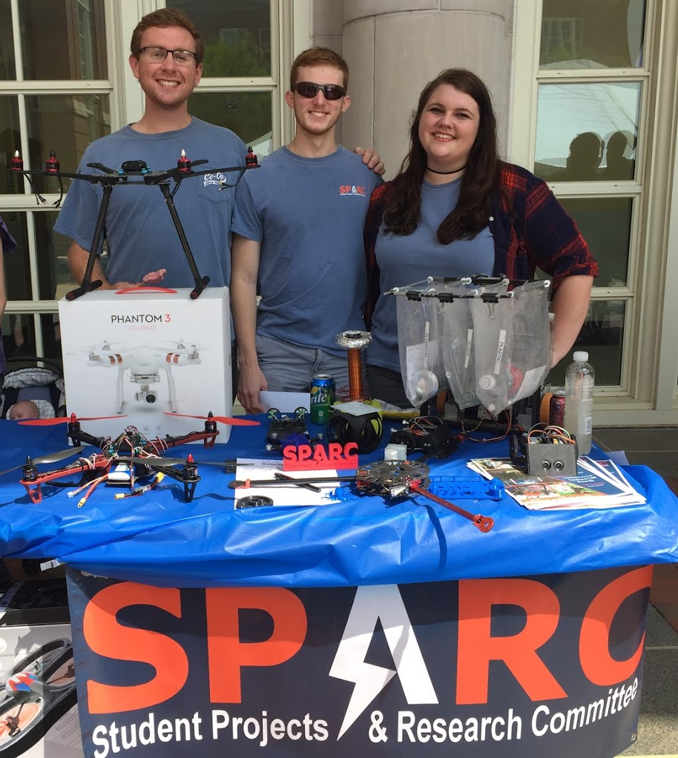
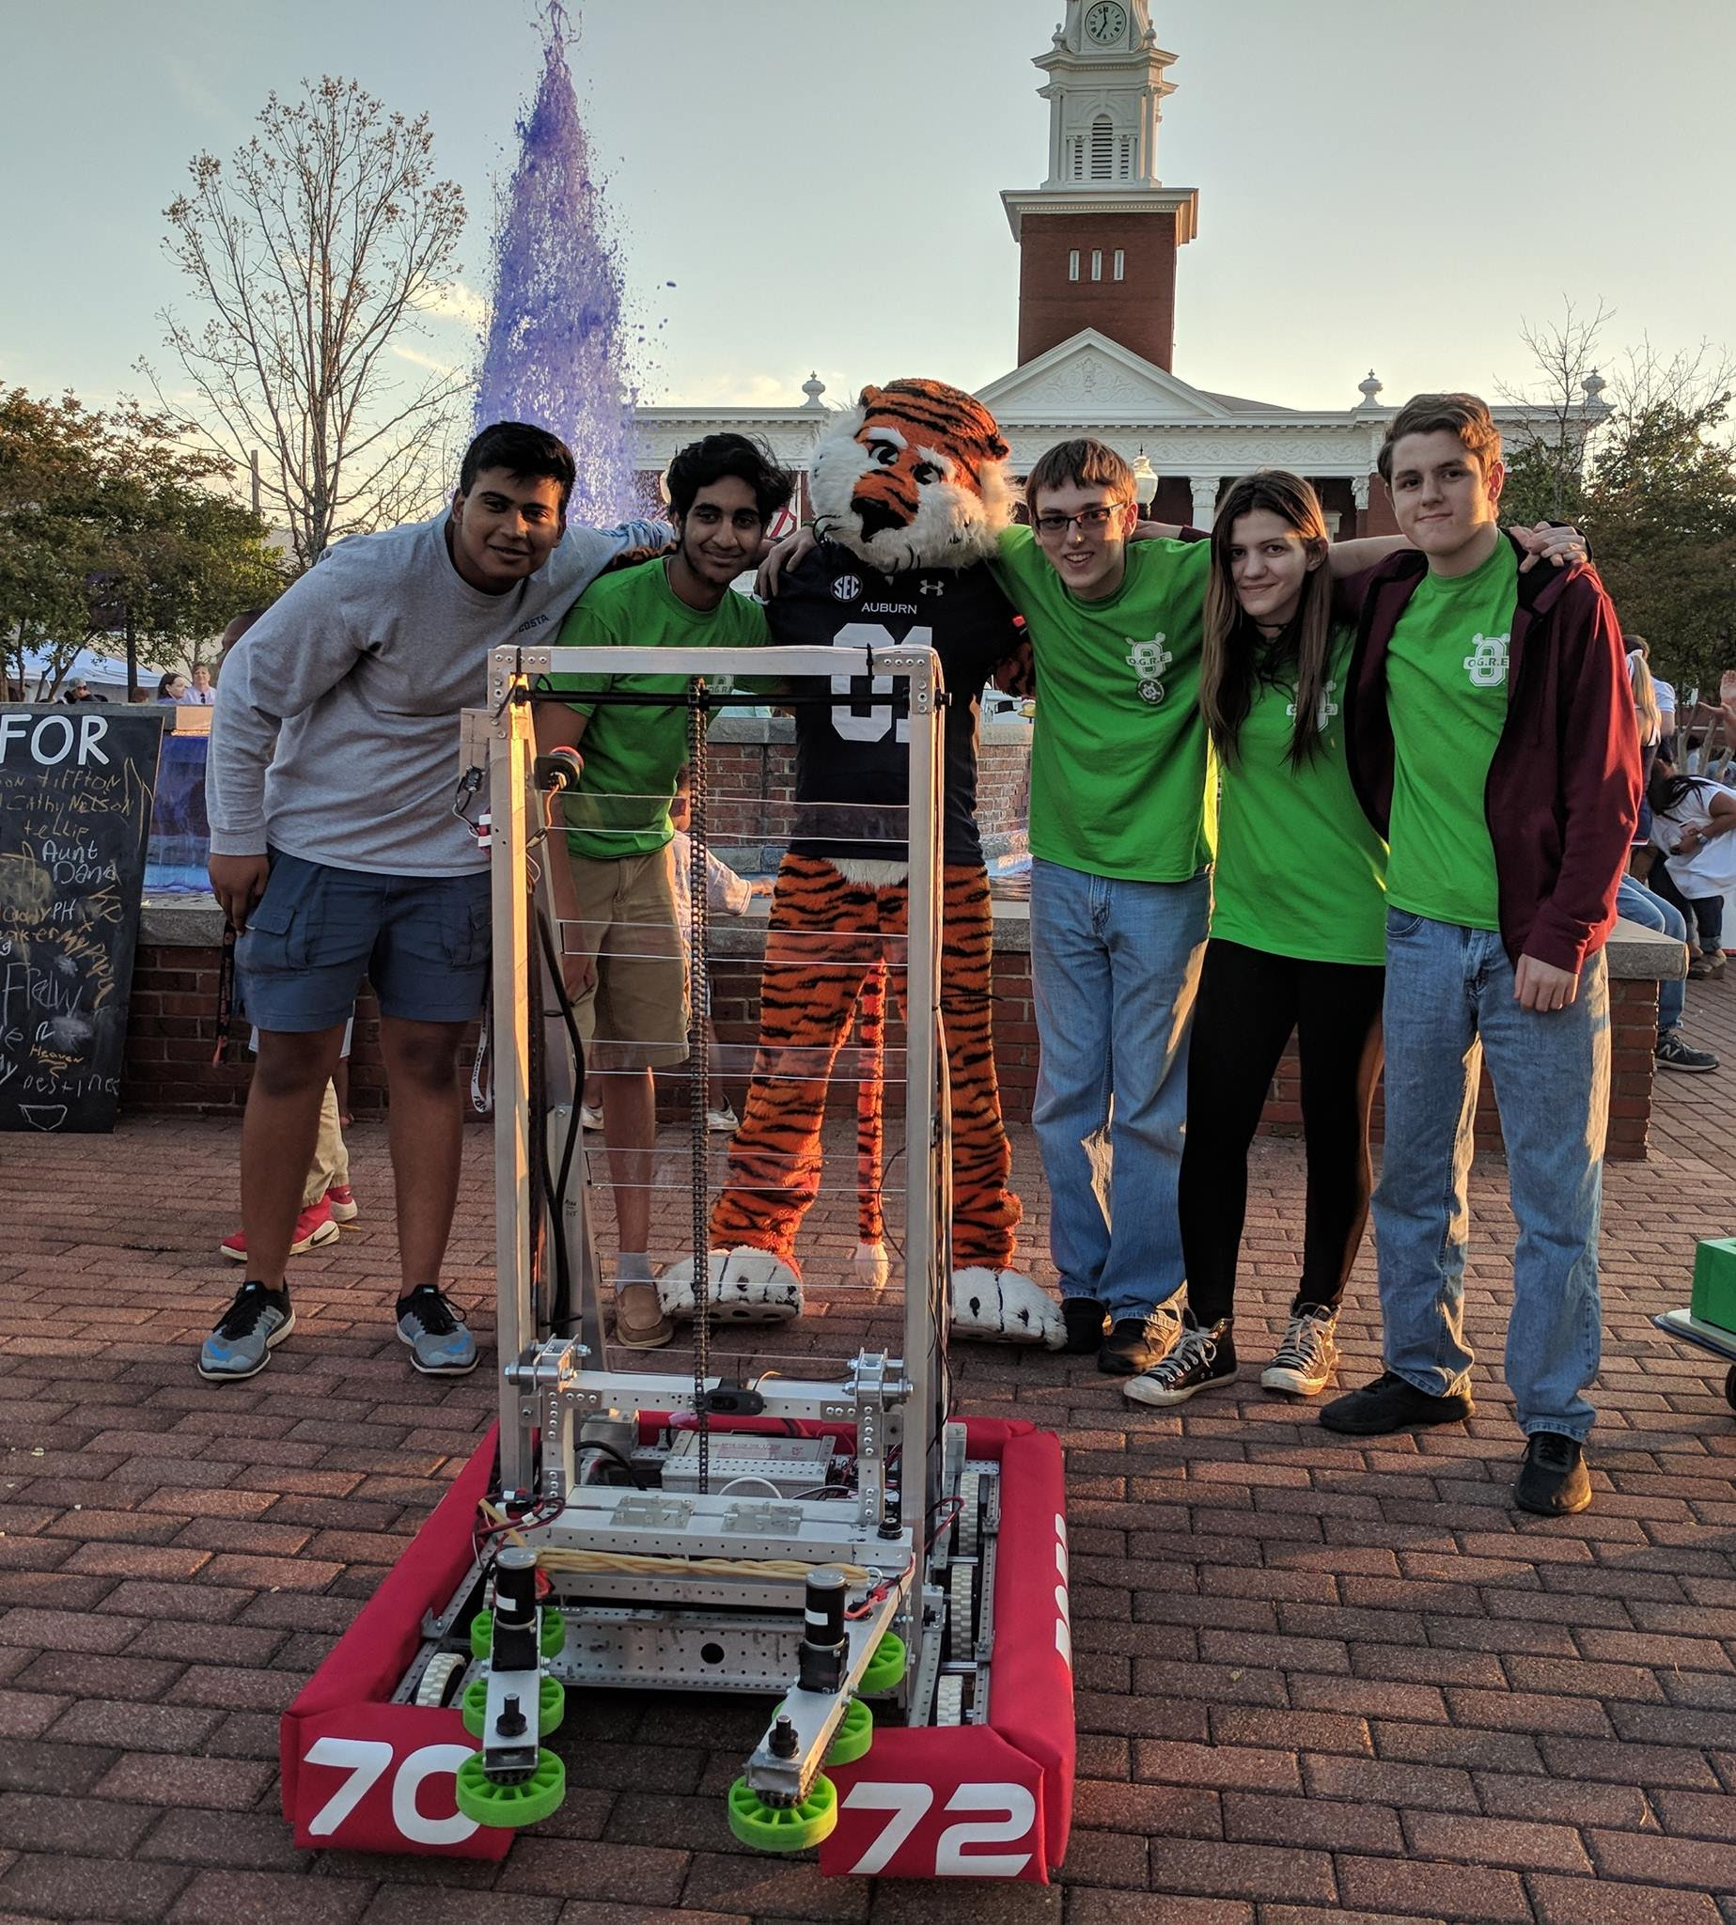
UPCOMING EVENTS
Opelika HS Robotics Team
Help mentor a local robotics team
Times: TWR: 3:30-6:30pm
Contact: Matthew Zacune <maz0006@auburn.edu>
Engineering BBQ 2018
FRC Team 7072 Bot
Notes:
Fall 2016
Loachapoka Robotics Mentoring- Mondays, Tuesdays, and Thursdays 3:00PM to 4:30PM
ECE Minority Presentation- November 14th
AJHS E-Day- November 17th
South’s Best- December 3-4th
SCORE Claw Machine- December 3-4th
Spring 2016
E-Day- Late February or early March
SPACE Day- Possible Event Next Semester
IEEE Sumo Robotics Competition (with local middle and high schools)- Spring 2017

Slide 11
PROJECT OPEN FORUM

Slide 12
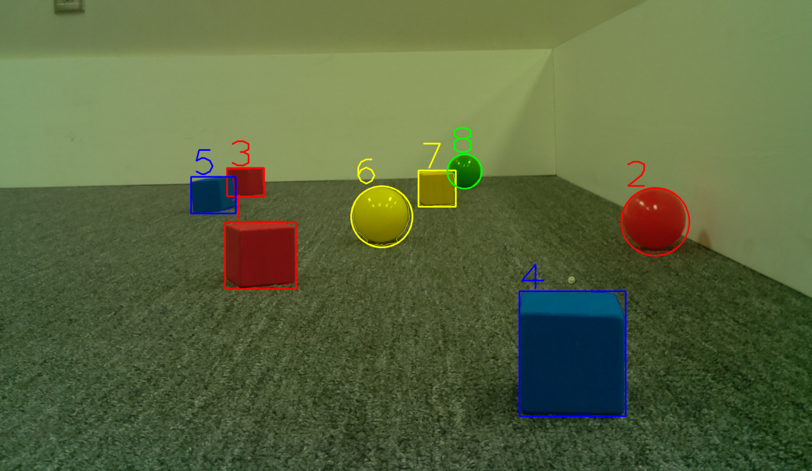
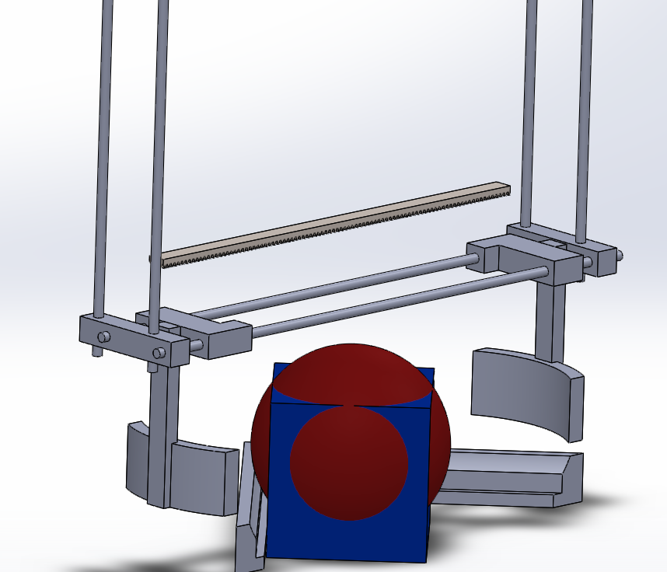
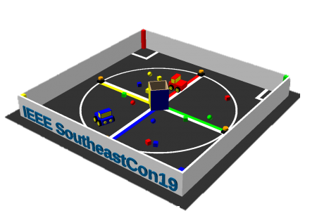
MAJOR PROJECT #1: IEEE SOUTHEAST CON
Project lead: Matthew Castleberry
Electrical lead: Josh Jablonowski
Mechanical lead: Alex Jones
Slack Channel: #projectieeeelectrical
Slack Channel: #projectieeemechanical
Competition Details:
Build a “space debris” collecting robot
Goal is to collect wood blocks and ball pit balls and deposit them on the side of a small flat ~100” square arena autonomously.
Max dimensions: 9” x 9” x 11”
When and Where:
Thursday, April 11th, 2019 through Sunday, April 14th, 2019.
IEEE Southeastcon conference in Huntsville, AL
Meeting Times
Electrical/Software Meeting: Tuesdays 12:30 - 2
Mechanical Meeting: Mondays 3 – 5
Programming Languages: C++,C
Gitlab: ask team lead for access

Slide 13
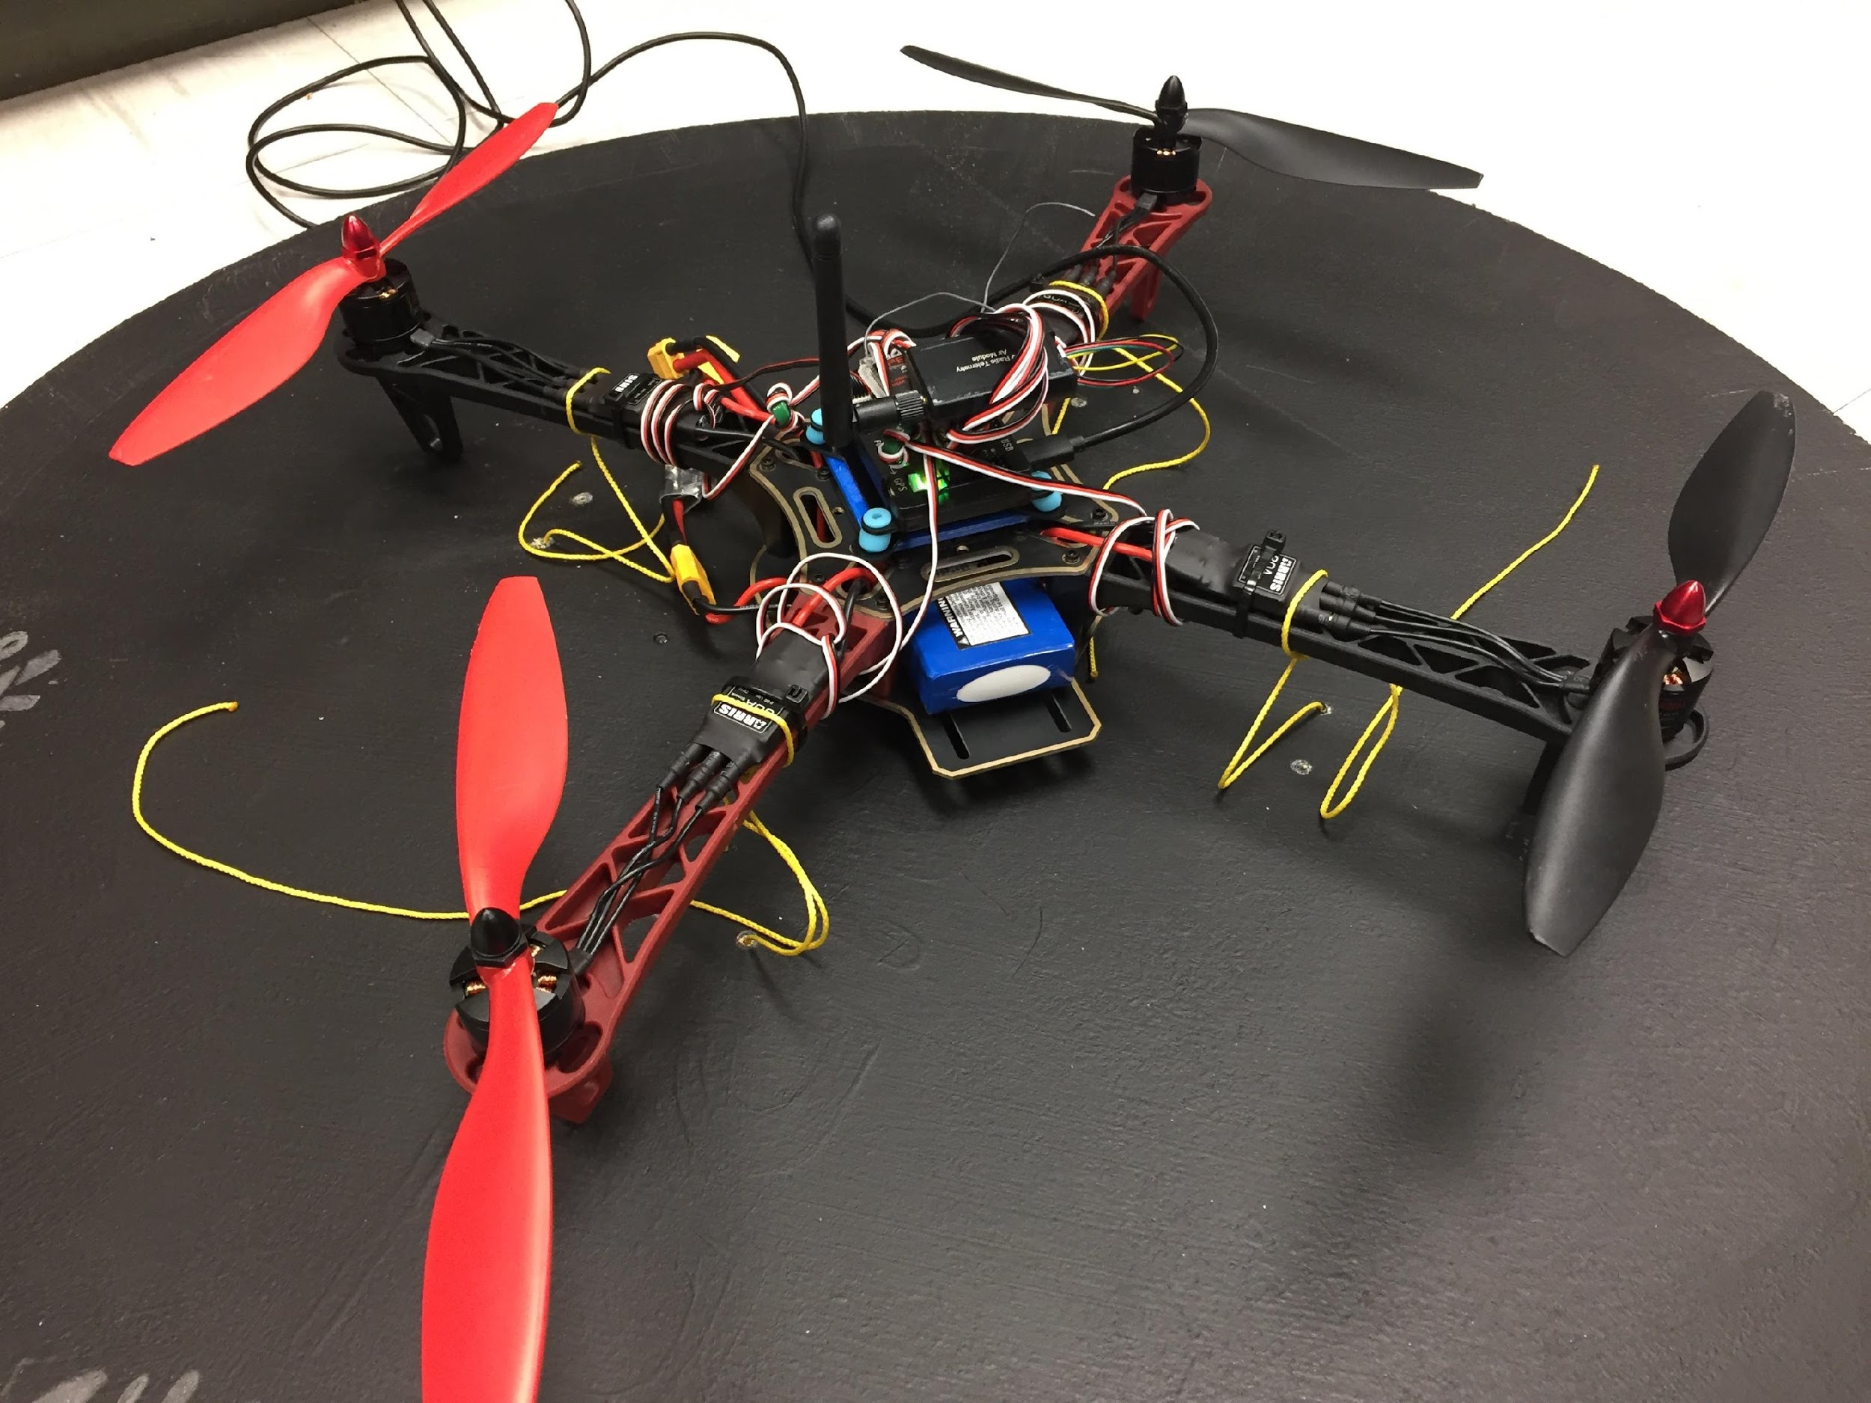
MAJOR PROJECT #2: MAIL BIRD
Project Lead: Joshua Parker
Slack Channel: #projectmailbird
Will be used to experiment with payload pickup, identification, and delivery
Partnership with RC Hobbyist Club
Semester Focus
Configure frame for waypoint navigation, etc.
Develop package release mechanism
Meeting Times
Wednesdays 11am – 1pm

Slide 14
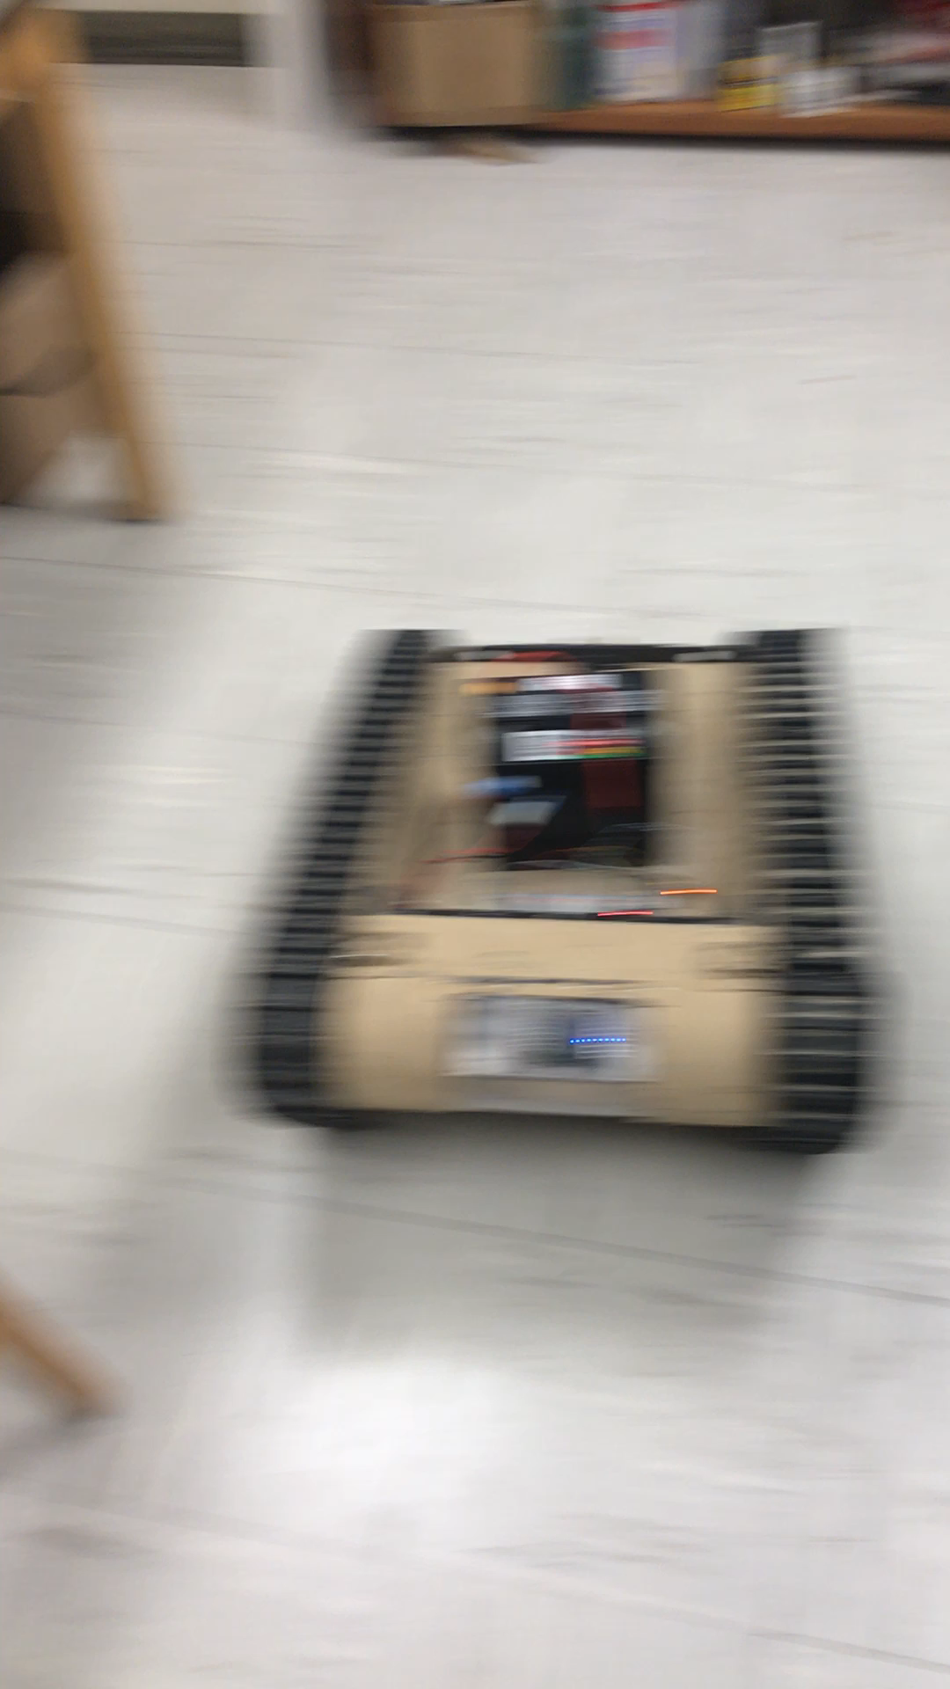
MAJOR PROJECT #3: MATILDA (Base)
Slack Channel: #projectmatildabase
Project lead: Ryan Moran
MATILDA stands for Mesa Associates' Tactical Integrated Light-Force Deployment Assembly
A bomb disposal robot from Dr. Roppel’s research lab.
Meeting Time:
Fridays 11:30 – 12:30
Semester Focus
Reestablishing mobility with wireless control
Establish autonomy with OpenCV
Potential add T-Shirt cannon to top
Github Repository
https://github.com/SPARC-Auburn/MATILDA-Base
Programming Languages
Python w/ OpenCV
C

Slide 15
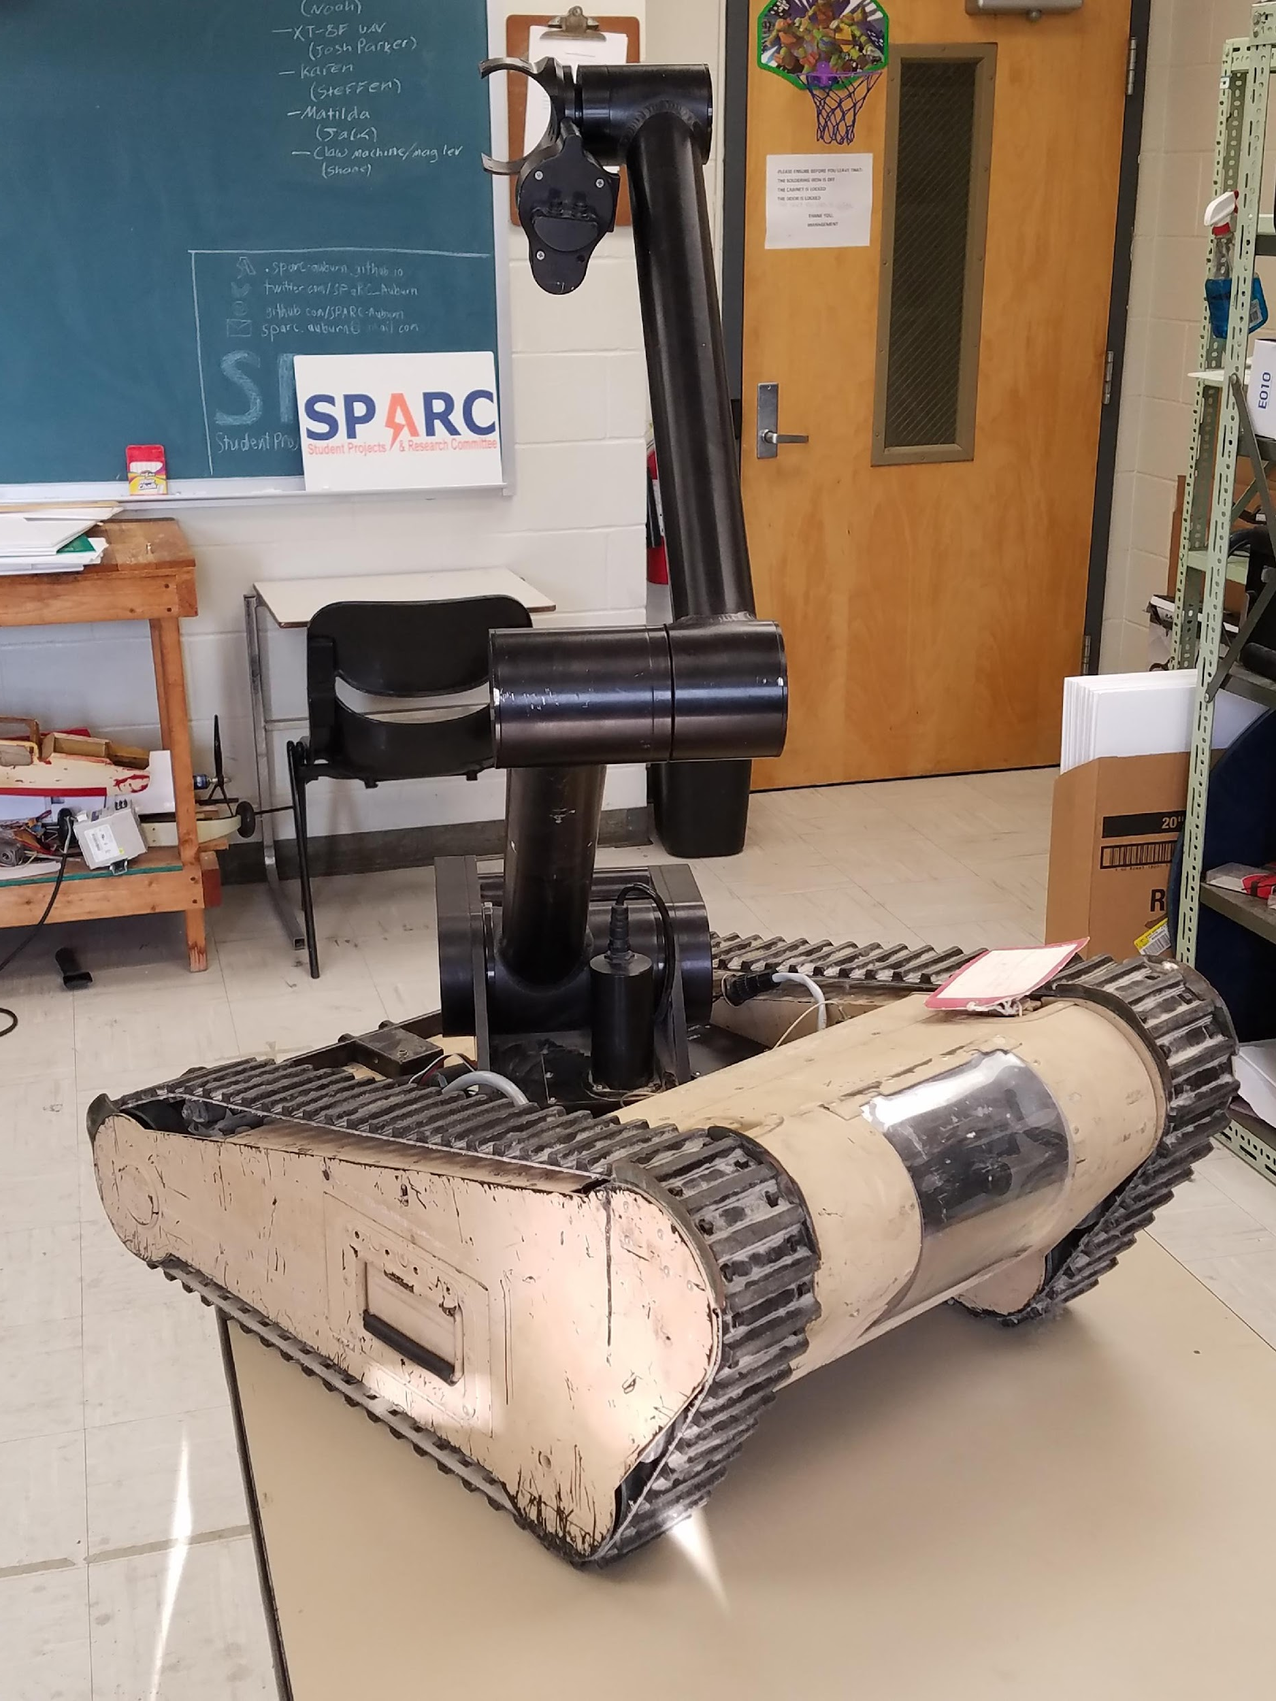
MAJOR PROJECT #3: MATILDA (Arm)
Slack Channel: #projectmatildarm
Project lead: Rice Shelley
MATILDA stands for Mesa Associates' Tactical Integrated Light-Force Deployment Assembly
A bomb disposal robot from Dr. Roppel’s research lab.
Meeting Times:
Thursdays 12:30 - 2
Semester Focus
Reestablishing arm control
Develop arm to play chess
Github Repository:
https://github.com/SPARC-Auburn/MATILDA-Arm
Programming Languages
Python w/ OpenCV
C

Slide 16
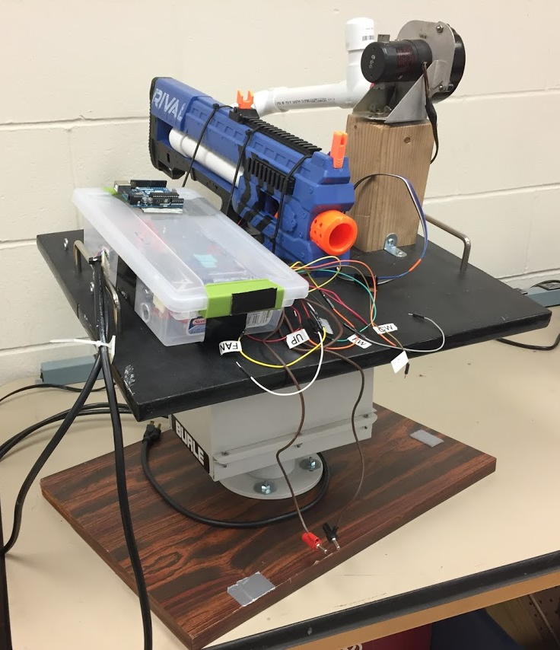
SIDE PROJECT #1: The Helpful Automated Defender (THAD)
Project lead: Josh Jablonowski
Slack Channel: #projectthad
Old project donated by EE department
It was demonstrated last spring at E-Day and PEAK.
Needs a new purpose to improve demonstrations
Github Repository:
https://github.com/SPARC-Auburn/THAD
Programming Languages
Python w/ OpenCV
C

Slide 17
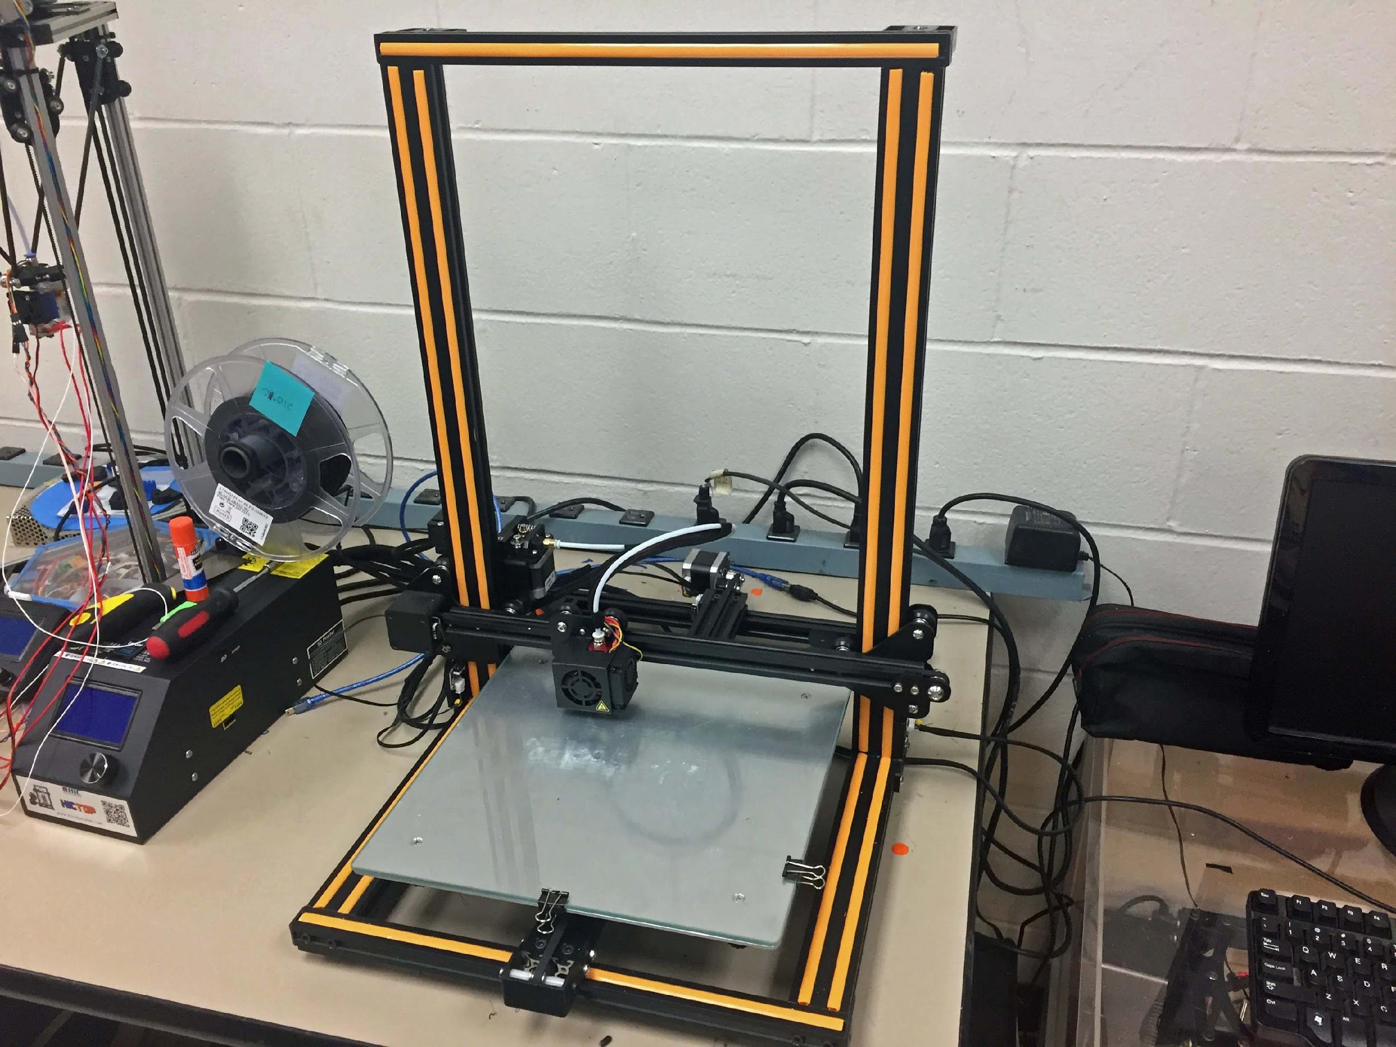
SIDE PROJECT #2: 3D PRINT ENCLOSURE
Project lead: Alex J. and Josh J.
Slack Channel: #3dprinting
Design double decker 3D printer enclosure to hold our Creality CR10 and Lulzbot Taz 3.
Will have wheels and have hinged doors
Will be a potential requirement based on new campus 3D printing rules.

Slide 18
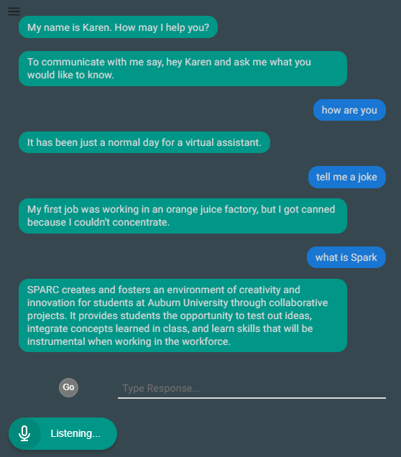
SIDE PROJECT #3: LAB ASSISTANT
Kinematic
Autonomous
Robot
Enriches
Newcomers
Lab
Information
Support
Tool
Project lead: Arthur Howard
Slack Channel: #projectlabassistant
Goal: create an automated lab assistant.
Is voice controlled.
One day will consist of both a stationary and mobile system.
Can be embedded on the new group chat system Slack.
Programmed in Node.JS (Framework of JavaScript)
Semester Focus
Add functionality
Add database for keeping track of members and equipment
Github Repository:
https://github.com/SPARC-Auburn/Lab-Assistant-IO
Programming Languages
Node.JS
Notes:
6:30

Slide 19
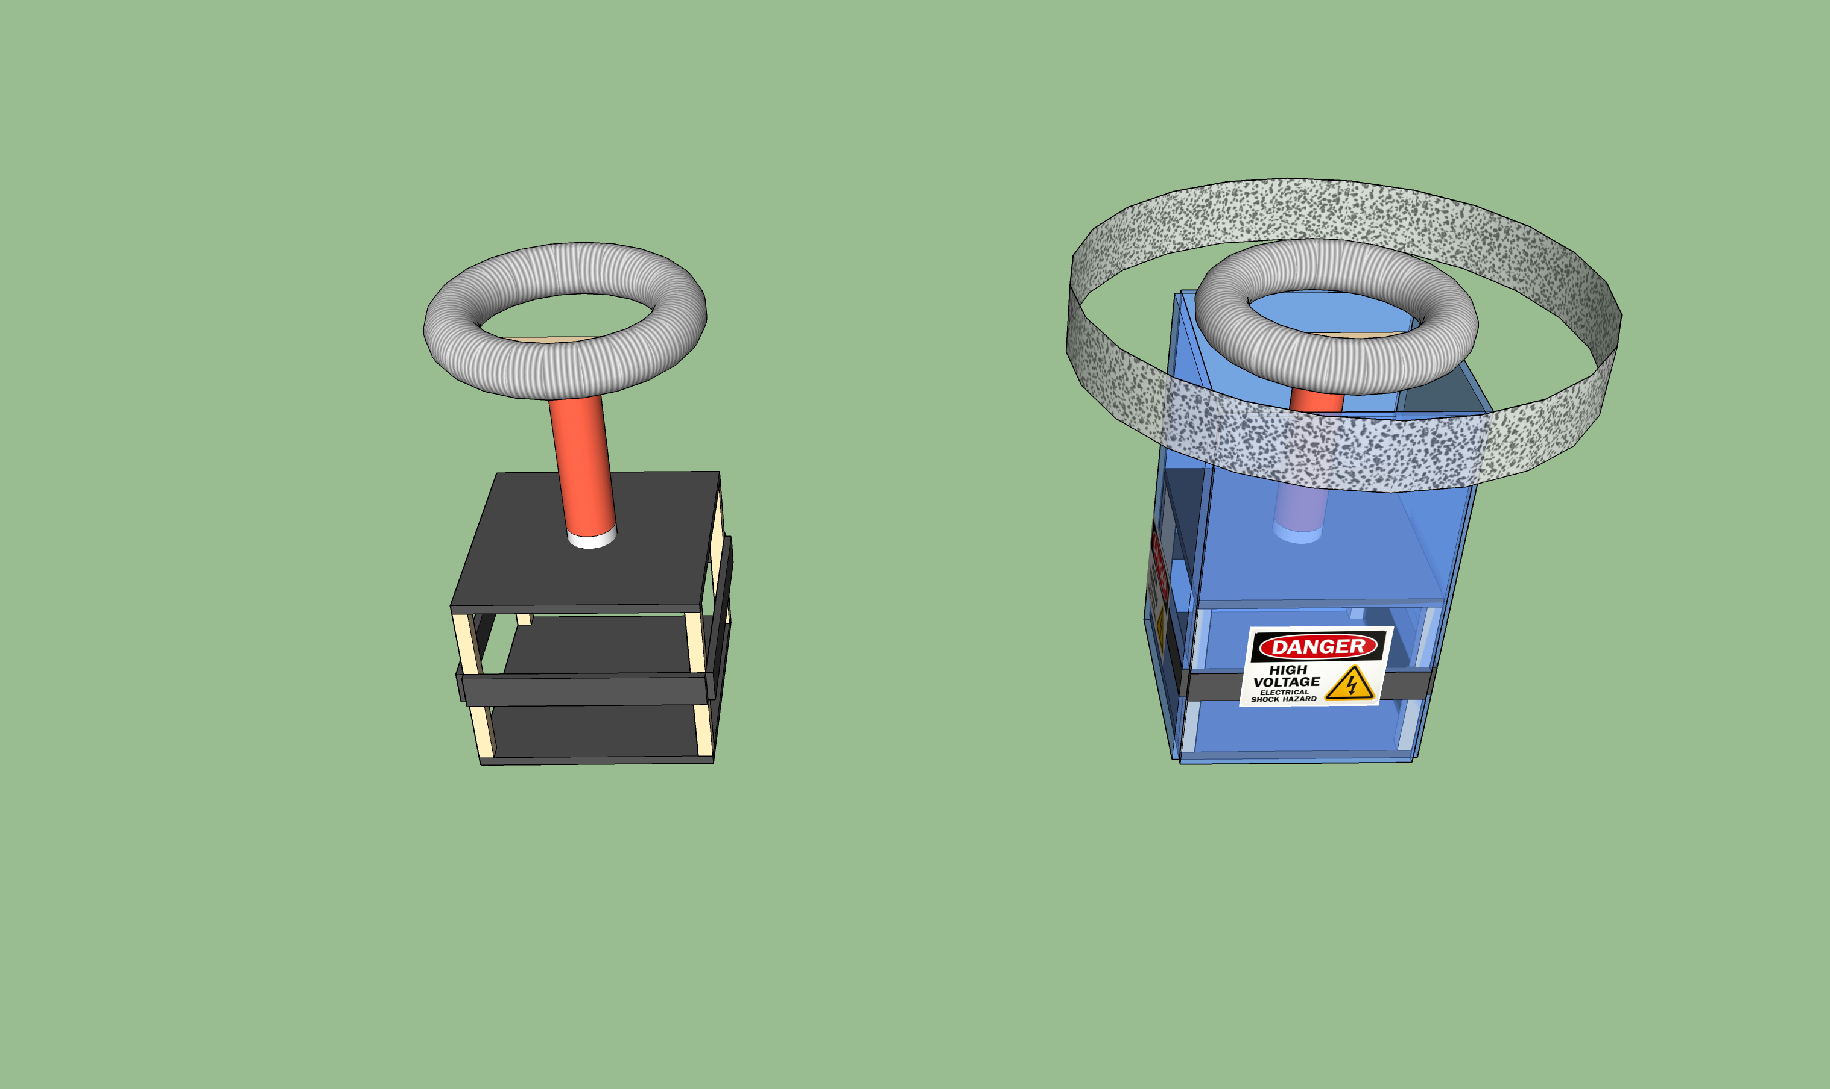
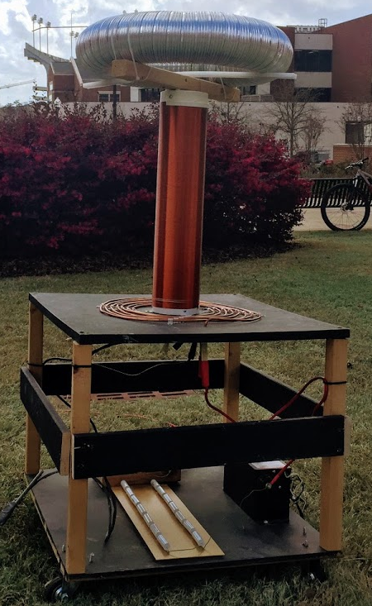
SIDE PROJECT #4: MUSICAL TESLA COIL
Project lead: Neil Postal
Slack Channel: #projectteslacoil
Demonstrated Tesla Coil at Spring 2016/18 E-Days
Currently uses spark gap style circuitry
Generated estimated 400,000 volts of electricity.
Semester Focus:
Increase safety precautions
Change from spark-gap design to solid-state design
Develop MIDI-input to allow music
Meeting times: Thursdays @ 3:30
Github: https://github.com/SPARC-Auburn/Tesla-Coil
Current Design
Possible safety precautions

Slide 20
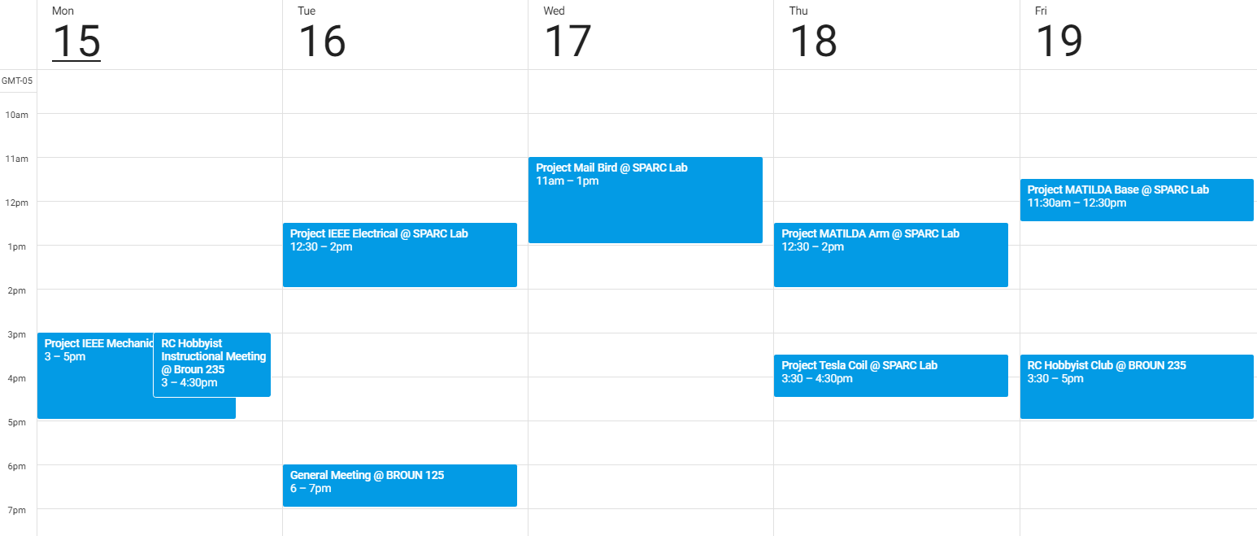
Meeting Schedule

Slide 21
PROJECT IDEAS?
email us at sparc.auburn@gmail.com
or DM Matthew Castleberry @mcberry23 via Slack

Slide 22
MAKER TRAINING SESSION:
Git and Version Control

Slide 23
Why use Version Control System (VCS)
Prevents loss of data by documenting all changes
If new bugs arise, files can be reverted back
Text based files allow line by line difference checking
Allows seamless collaboration on technical projects
Git is a VCS for software development
Repository
Version 1
Version 2
Version 3
commit
sync
commit
sync
commit
sync
User A
User B
User C

Slide 24

Definition of Terms
Repository (Master Branch)- a central location in which data is stored and managed.
Branch- an alternative version of the repository
Clone- copying of files from a repository into a local branch
Commit- push and pull from local branch to repository

Slide 25

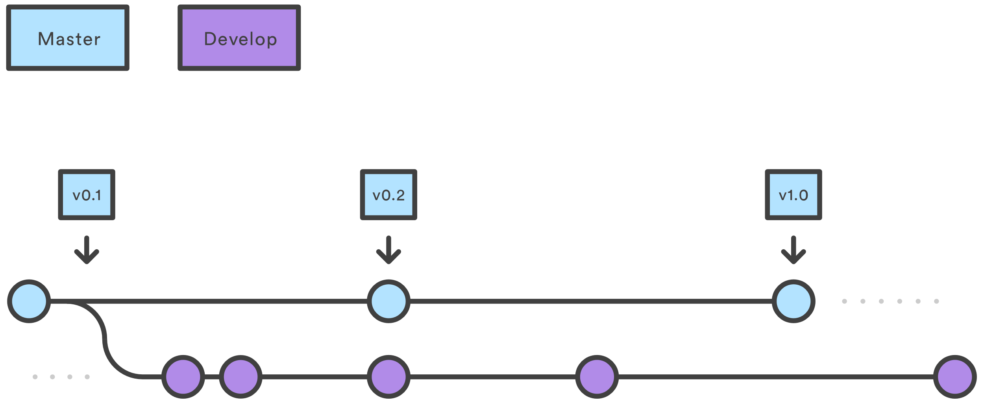
Basic Git Work Flow
https://www.atlassian.com/git/tutorials/comparing-workflows/gitflow-workflow

Slide 26
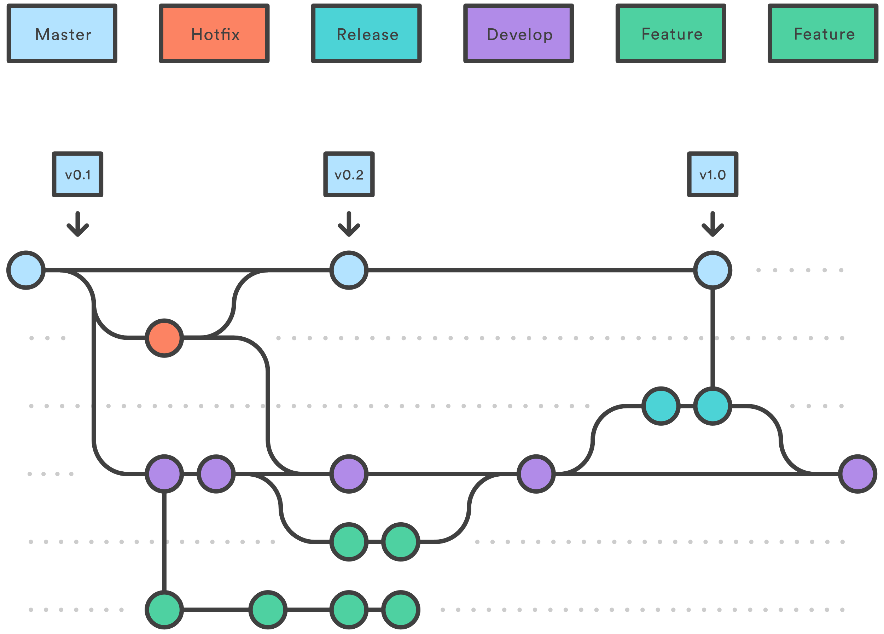
Expanded Git Work Flow
https://www.atlassian.com/git/tutorials/comparing-workflows/gitflow-workflow

Slide 27
What is GitHub
GitHub is an online Git VCS for software developers.
Advertised as “social coding”
It is free, open source, and widely used.
Is not limited to just software files.
SPARC projects and documents are highly integrated into GitHub
Free private repository alternative: GitLab

Slide 28
Ways to Use Git and Github
Basic (GUI)
GitKraken
SourceTree
GitHub Desktop
Advanced (Terminal/GitBash)
Use terminal Commands after installing git on operating system
Example Commands:
git clone /path/to/repository
git commit -m "Commit message"
git push origin master
git pull
git status
More commands: https://git-scm.com/docs

Slide 29
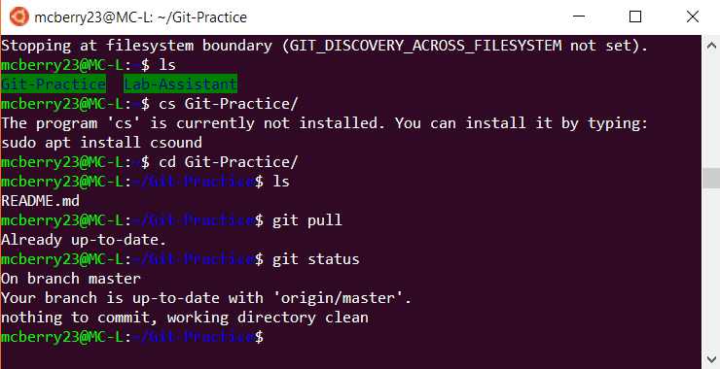
Using Git in Debian Linux
Ensure git is installed
sudo apt-get update
sudo apt-get install git
Change directory into desired location: cd directoryname
Use commands in terminal
git clone, git commit, git push, git pull, etc.

Slide 30
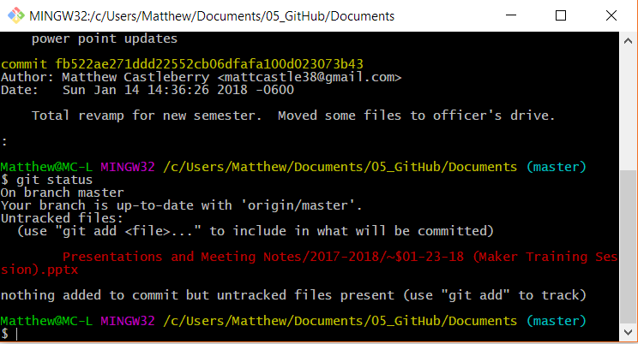
Using Git in Git Bash
Install from (https://git-scm.com/downloads)
Right click desired directory and press “GIT BASH Here”
Use commands in terminal
git clone, git commit, git push, git pull, etc.

Slide 31

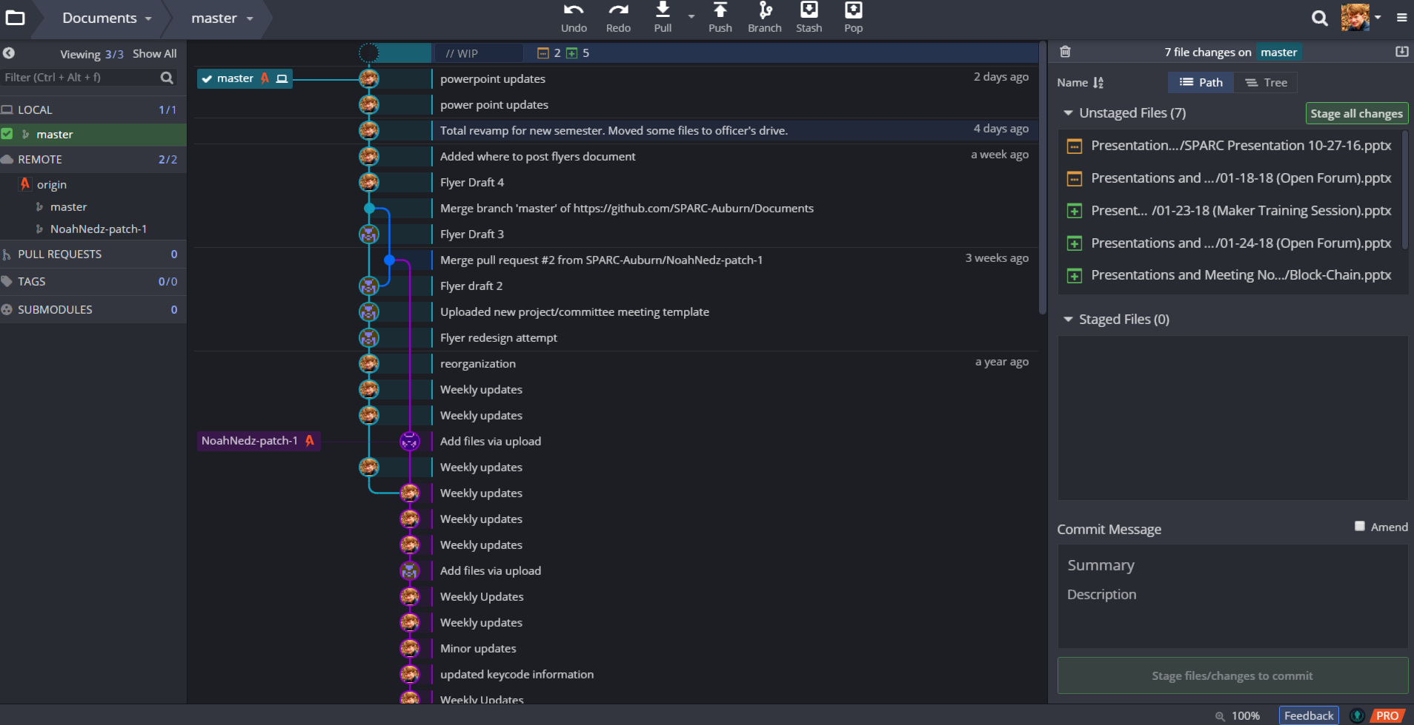
Using Git iN

Slide 32
Typical Basic Git Procedure
Setup repository
> git clone “https://urltorepository”
> git init
Initial Commit
add files to folder
> git add –A
> git commit –m “Initial Commit”
> git push
Later Commits
> git pull
make file changes
> git add –A
> git commit –m “Description of changes”
> git push

Slide 33
Practicing Git
Many resources and tutorials are available online
Codecademy: https://www.codecademy.com/learn/learn-git
CodeSchool/Github: https://try.github.io/levels/1/challenges/1
Experiment with our practice GitHub repository
Github/SPARC-Auburn: https://github.com/SPARC-Auburn/Git-Practice

Slide 34
Access to SPARC Git accounts?
Github (public): https://github.com/SPARC-Auburn
Gitlab (private): https://gitlab.com/SPARC-Auburn
used exclusively for competition teams
contact us at sparc.auburn@gmail.com for access

Slide 35
QUESTIONS?

